Slide 1
Framework of Data Preparation
Topic: Prediction on Natural Rubber’s Price in Cambodia using Machine Learning
Objective: To determine which machine learning model is the best for prediction

Slide 2
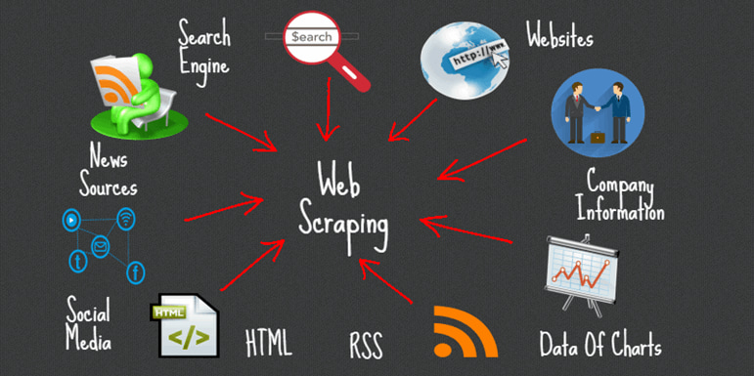
Data Collection _ Web Scraping
https://www.cambodiantr.gov.kh/index.php?r=tradeInfo/listAll
https://www.selinawamucii.com/insights/prices/cambodia/natural-rubber/#:~:text=Cambodia%20natural%20rubber%20wholesale%20price,Siem%20Reap%20and%20Phnom%20Penh

Slide 3
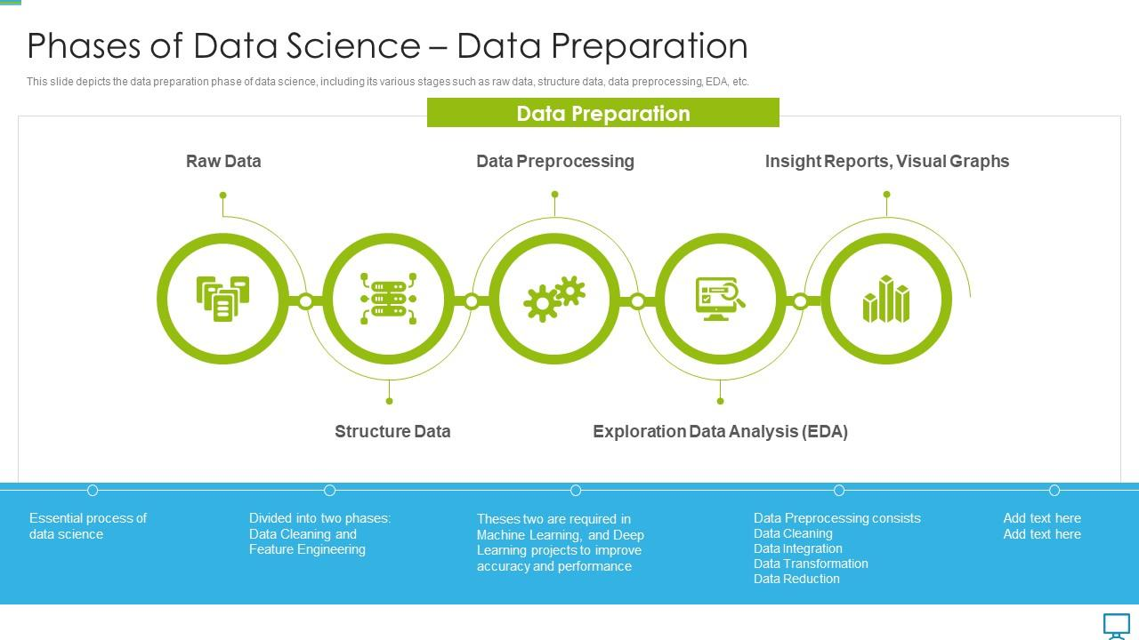
Data Preparation

Slide 4
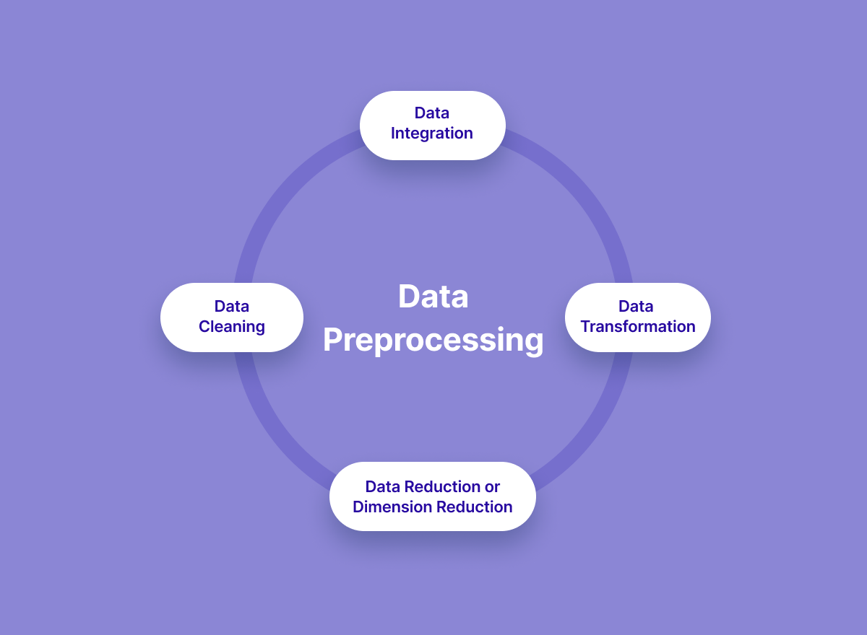
Data Preprocessing

Slide 5
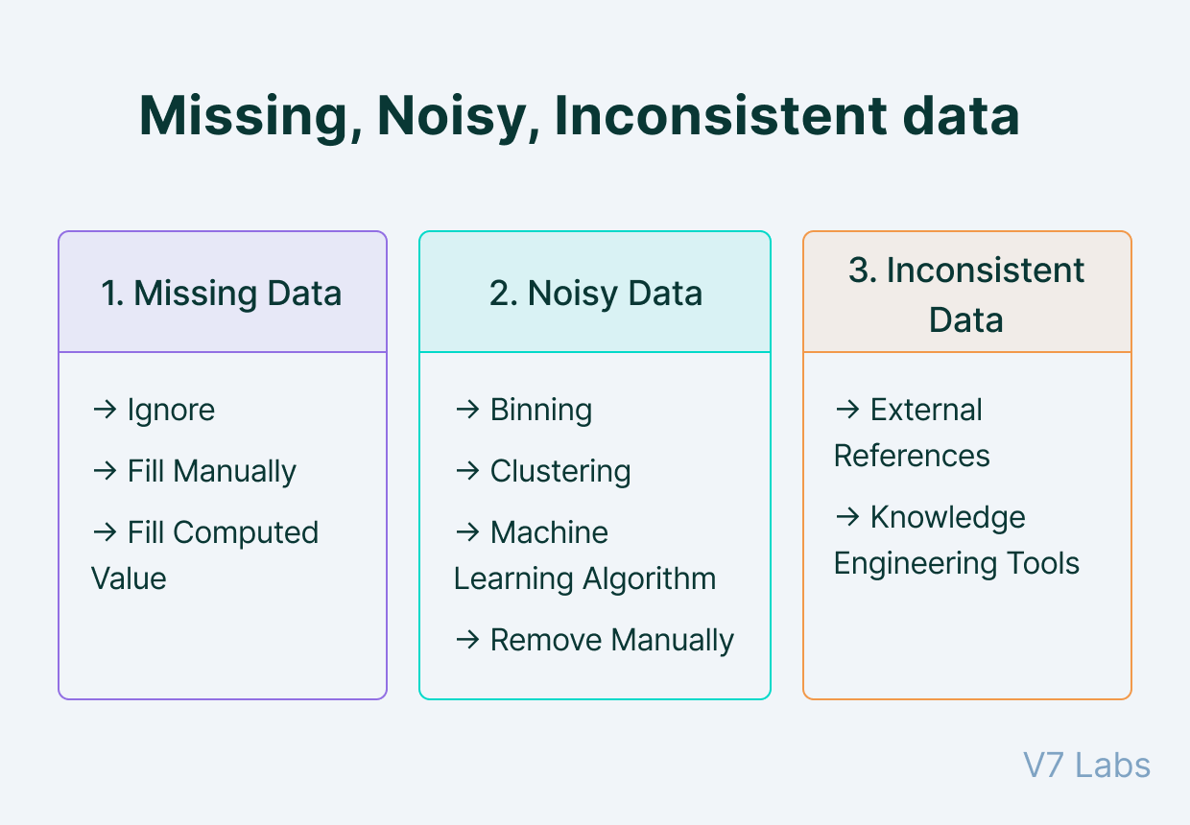
Data Cleansing
Data Cleaning is particularly done as part of data preprocessing to clean the data by filling missing values, smoothing the noisy data, resolving the inconsistency, and removing outliers.

Slide 6
Data Integration
Data Integration is one of the data preprocessing steps that are used to merge the data present in multiple sources into a single larger data store like a data warehouse.
We might run into some issues while adopting Data Integration as one of the Data Preprocessing steps:
Schema integration and object matching: The data can be present in different formats, and attributes that might cause difficulty in data integration.
Removing redundant attributes from all data sources.
Detection and resolution of data value conflicts.

Slide 7
Data Transformation
Once data clearing has been done, we need to consolidate the quality data into alternate forms by changing the value, structure, or format of data using the below-mentioned Data Transformation strategies.
Generalization
Normalization
Min-max normalization
Z-Score normalization
Decimal scaling normalization
3. Attribute Selection
4. Aggregation

Slide 8
Data Reduction
Here is a walkthrough of various Data Reduction strategies.
Data cube aggregation
Dimensionality reduction
Data compression
Discretization
Numerosity reduction
Attribute subset selection

